Slide 1
Introduction:
Is Perception Everything?

Slide 2
What is Perspective?
Perspective is a viewpoint or way of looking at the world, or a particular conception of things or events.
Our perspective influences how we perceive the world.

Slide 3
Directions:
1. Get out a sheet of paper
2. Write 3 sentences in response to the following question:
Is seeing and understanding shaped by how we perceive the world? How?
3. Share your response with a neighbor.

Slide 4
Directions:
1. Now, number your (same) sheet of paper
#1-12.
2. As you watch the following video, write down what you see.
https://www.youtube.com/watch?v=8GoFOhcKqfw
https://www.youtube.com/watch?v=Fzn_AKN67oI
https://www.youtube.com/watch?v=8jhcxOhIMAQ
https://www.youtube.com/watch?v=llLVk2fqylA&t=620s
What makes your perception change?

Slide 5
When you were little, what did you want to be when your grew up?

Slide 7
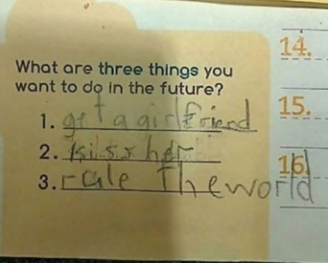

Slide 8
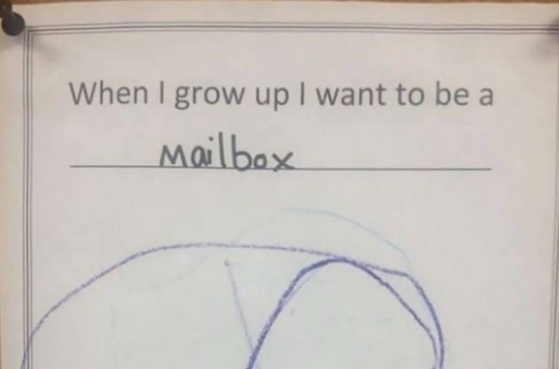

Slide 10
Quick write prompt: On same sheet of paper. (5-6 sentences)
Now that you are a senior, how has your perception changed on what it means to be an adult? When you were little, what did it mean to you to be an adult? What does it mean now?
Has your opinion changed on what it means to be independent? To make your own choices? To be responsible for those choices?

Slide 11
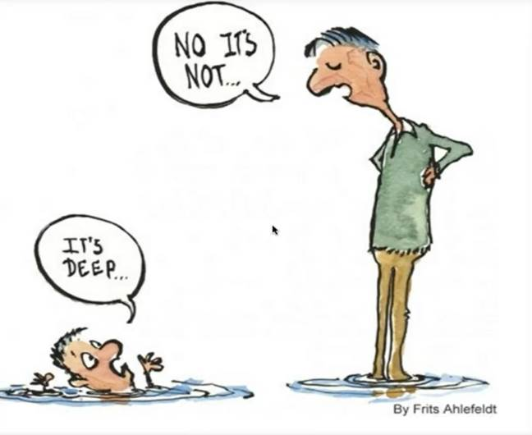

Slide 12
Directions: Aphorism
An aphorism is a short statement, usually one sentence, that uniquely expresses an opinion, perception, or general truth.
In your group of 4-5 people, read through the Aphorism worksheet. Discuss what these aphorisms mean.
Select 5 statements to paraphrase.
Select 2 that your group agrees with.
Illustrate those 2 aphorisms (separate sheet each). Include the aphorism as well as a paragraph that explains how they relate to the idea that seeing and understanding are always shaped by how we perceive the world.

Slide 13
When you were a kid, what did you want to be when you grew up? We're asking because the Harris Poll just did a survey asking American kids what they want to be.
"Vlogger" and "YouTube star" ranked number one. Astronaut got the lowest response. The poll was done in honor of the 50th anniversary of the moon landing.
*29 percent of Americans said "YouTuber" *28 percent said teacher *23 percent said pro athlete *Astronaut got 11 percent.
Source: https://abc7news.com/society/new-poll-reveals-what-american-kids-want-to-be-when-they-grow-up/5404052/ accessed 07/26/19, copyrighted 2019

